Slide 1
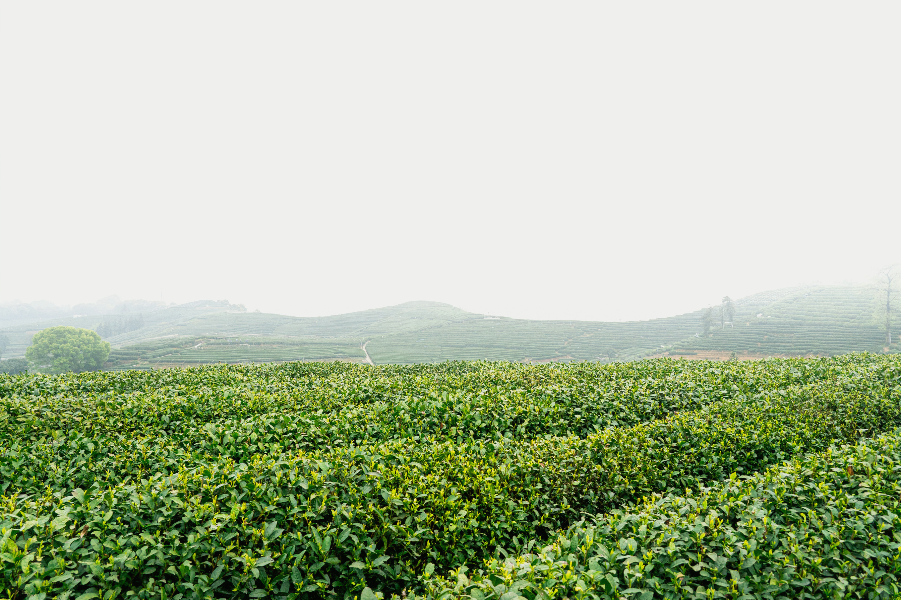


SMART AI FARMING ASSISTANT

Slide 2
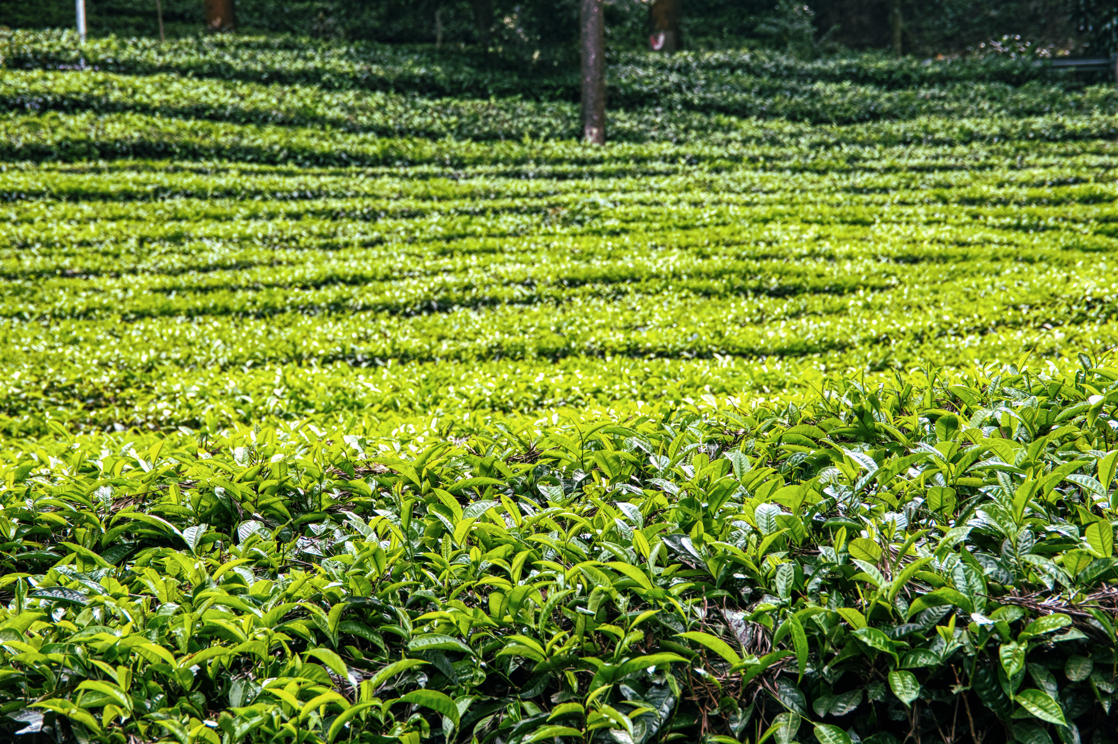
Challenges
Farmers Face Today
Unpredictable Weather
Rain may come early, late, or
not at all, making crop planning
extremely difficult for farmers.
Language Barriers
Many farmers cannot read English or navigate complex agricultural applications effectively.
Wrong Crop Choices
Selecting unsuitable crops leads to devastating failures and significant financial losses for farming families.
Information Gaps
Farmers lack access to current market prices, government schemes, and disease identification expertise.
30 - 11 - 26
PRESENTATION BY
AARON LOEB

Slide 3
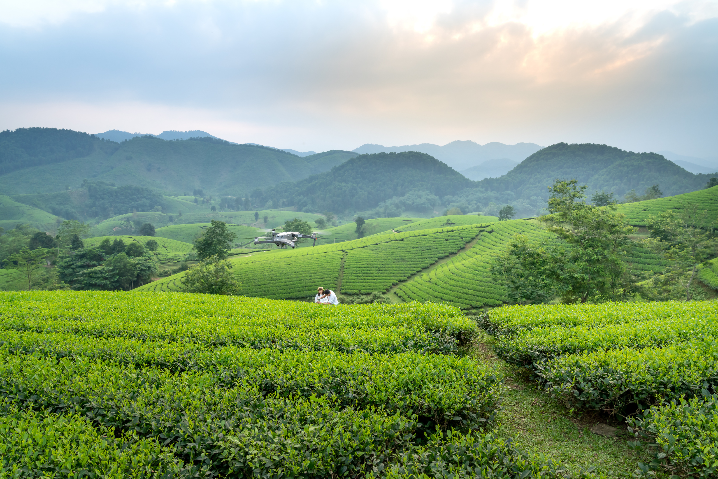
01
Weather & Crop Prediction
AI models predict weather patterns and
recommend optimal crops for local conditions.
Smart Solution
02
Multilingual Communication
for Multiple Problems
Farmers can interact in Hindi or Gujarati
through voice and text interfaces.
03
Comprehensive Guidance
Provides market insights, disease identification,
and government scheme information.

Slide 4
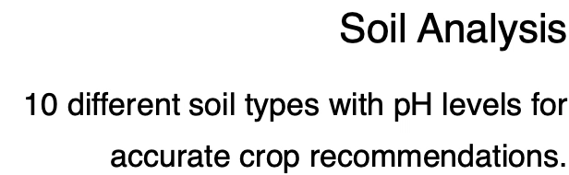
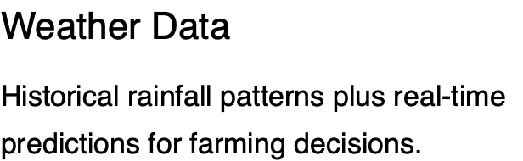








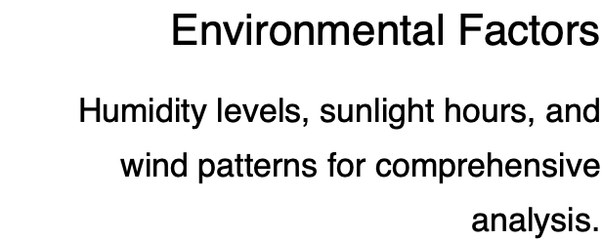
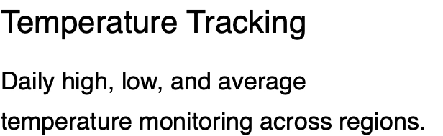

Slide 5
Smart Forecasting & Recommendations
Weather Forecasting
AI predict rainfall amount, duration, and probability with good accuracy for local microclimates.
Crop Recommendations
AI suggests optimal crops based on soil type, predicted weather conditions, and historical yield data for maximum profitability.
30 - 11 - 26
PRESENTATION BY
AARON LOEB

Slide 6
thank you

